Slide 1
Exclusive Catalog
ROERMOND

Slide 2
OUR SERVICE
CLICK & COLLECT
Free & immediate (priority – skip the line)
L’OCCITANE EN PROVENCE
ROERMOND
Stadsweide 116
6041 TD Roermond
+31 475 335 656
nlstore.outlet@loccitane.com
CONTACT US

Slide 3
MY ESSENTIAL

Slide 4
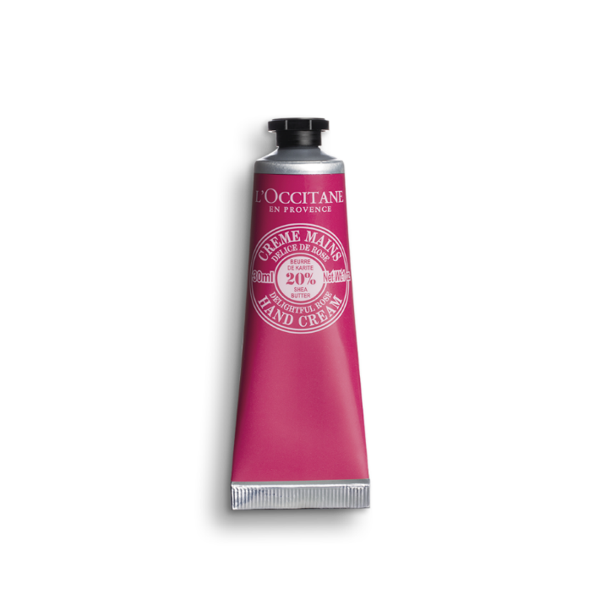
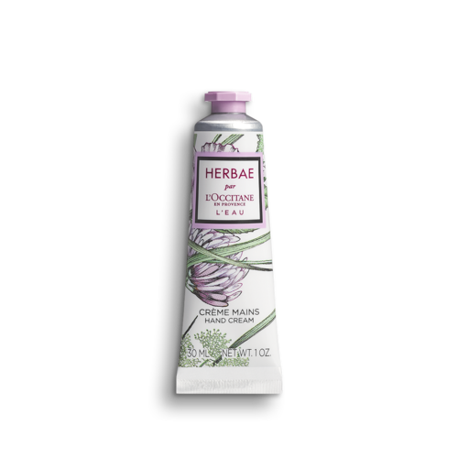
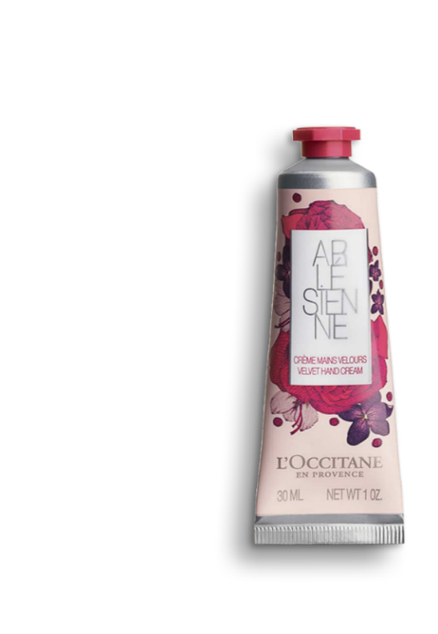
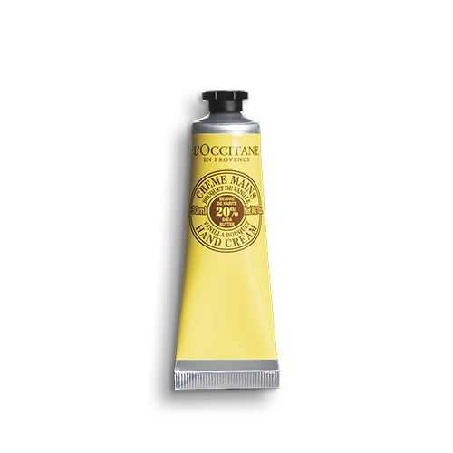
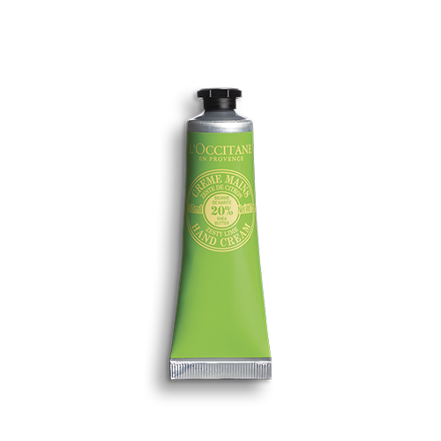
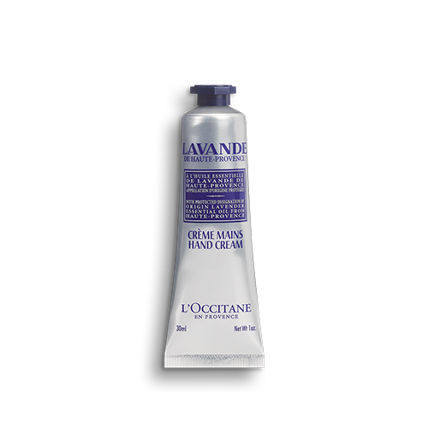
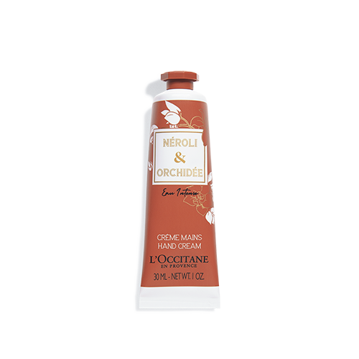
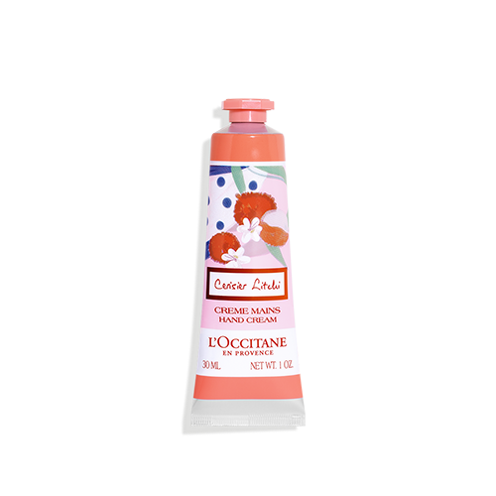
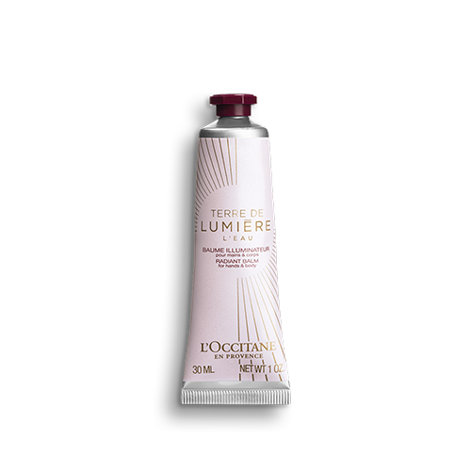
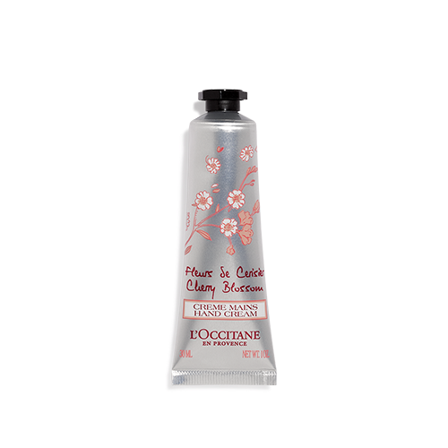
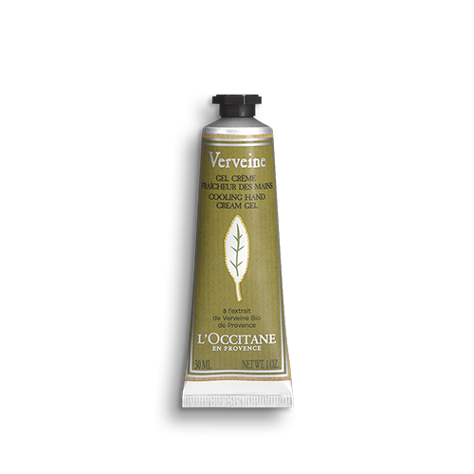
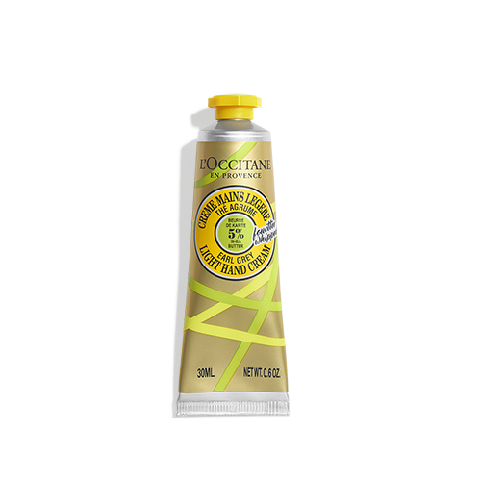
Hand Cream Trio
€16,50 instead of €25,50
One L'OCCITANE hand cream
is sold every 2 seconds* in the world !
*Year 2020
24MA030P15trio
01MR030K14trio
15MA030VA5trio
30MA030TV20trio
15MA030VB19trio
24MA030S6trio
29MA030A17trio
15MA030L11trio

Slide 5
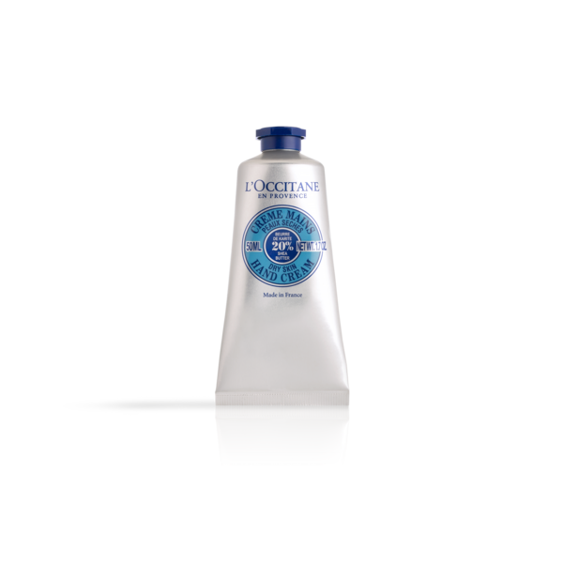
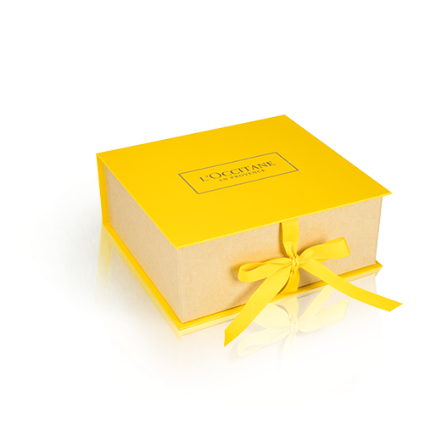
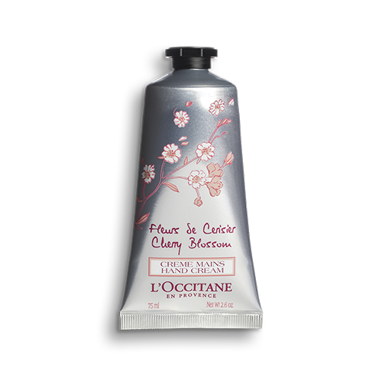
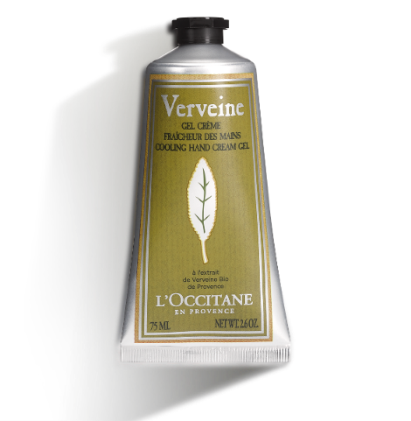
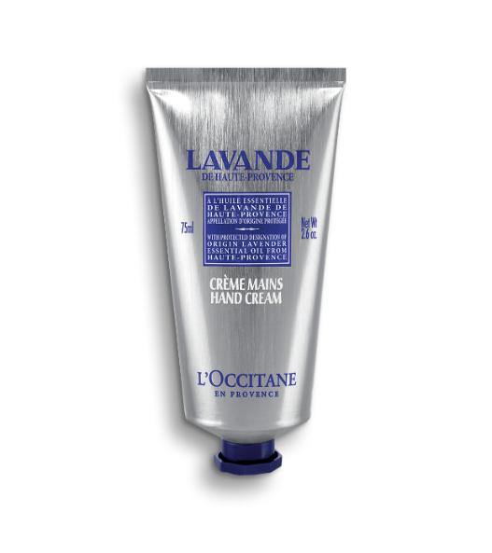
Hand Cream Duo
PPLDUOSHEACM22
Shea Butter Hand Cream Duo 50ml
€19,00 instead of €24,00
Hand Cream Duo Verbena & Cherry Blossom 75ml
PPL3HCDUOUT20
€25,00 instead of €38,00
PPL1HCDUOUT22
Hand Cream Duo Lavender & Cherry Blossom 75ml
€25,00 instead of €38,00
PPL2HCDUOUT22
Hand Cream Duo
Lavender & Verbena 75ml
€25,00 instead of €38,00

Slide 6
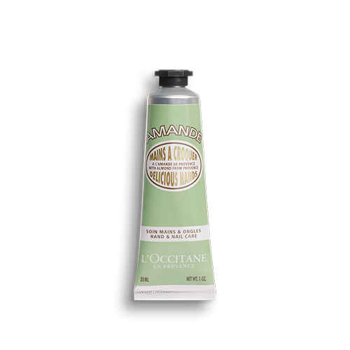
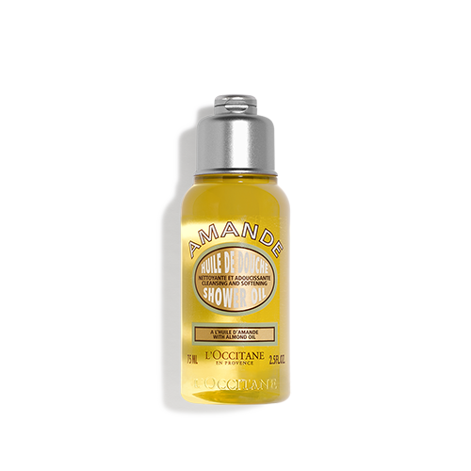
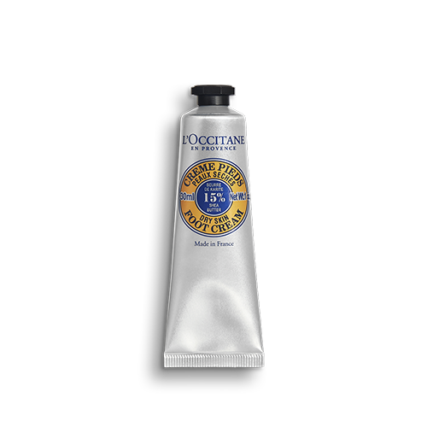
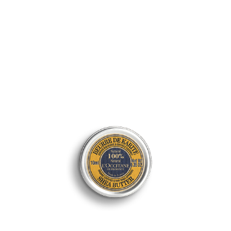
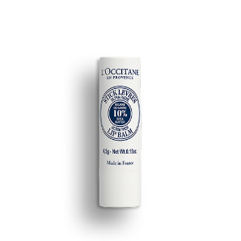
Duo Lip Balm & Hand Cream
€11,50 instead of €17,50
PPLDUOLBFDCHCALM
Hand Cream 30ml
Cherry Lip Balm 12ml
Almond Hand Cream & Shower
€10,50 instead of €16,00
- Shower Oil 75ml
- Hand Cream 30ml
PPLOUTDUOALMSOHC
Shea Butter Foot Duo
€11,00 instead of €17,00
PPLSHEAFOOTDUO
PPLOUTTRIOLIP
Trio Shea Lip Balm
OR
Trio Shea Butter
PPLOUTTRIOSHEA10
€18,00 instead of €27,00

Slide 7
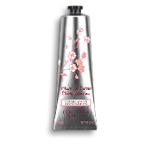
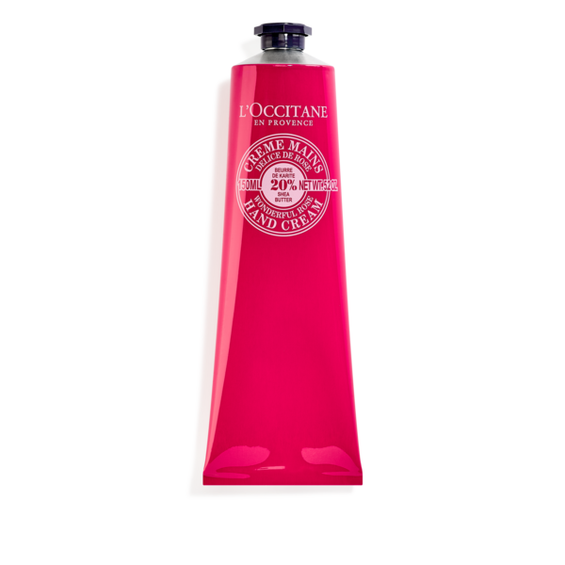
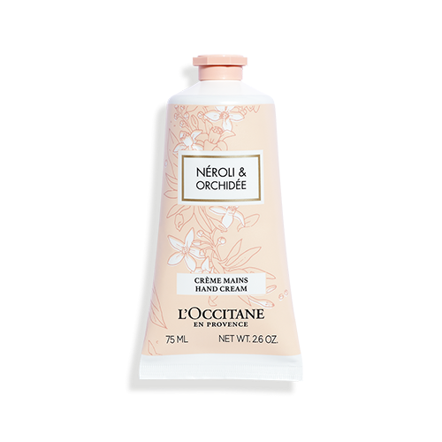
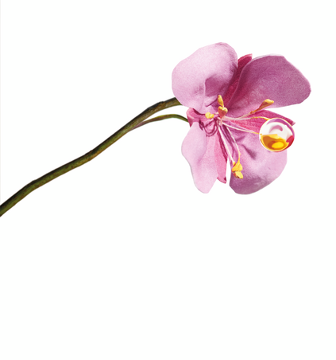
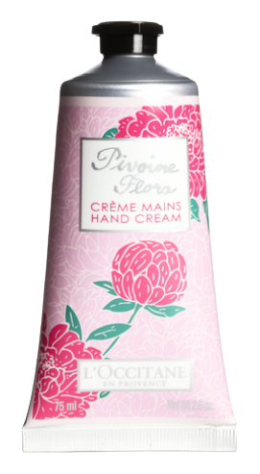
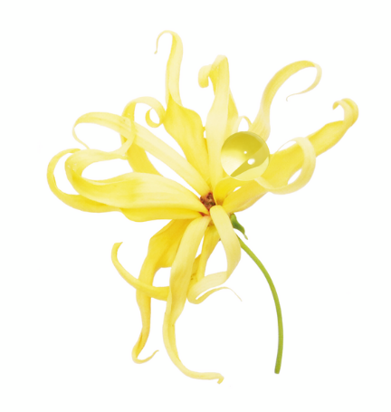
Cherry Hand Cream 150ml
€16,00 instead of €24,00
Rose Shea Hand Cream 150ml
€16,00 instead of €24,00
Neroli Orchid Hand Cream 75ml
€17,00 instead of €19,00
Pivoine Flora Hand cream 75ml
€12,50 instead of €19,00

Slide 8
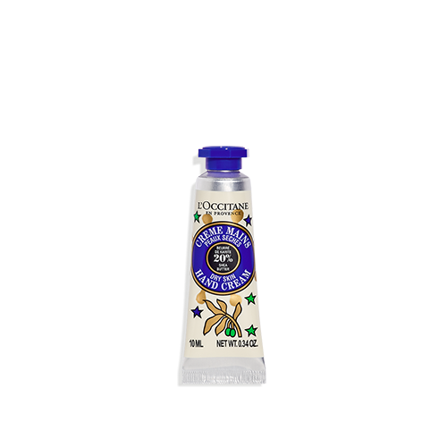
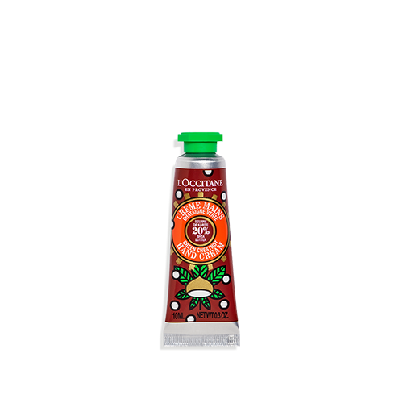
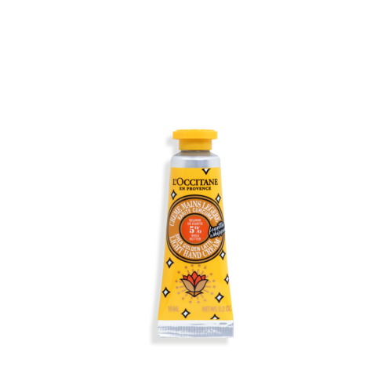
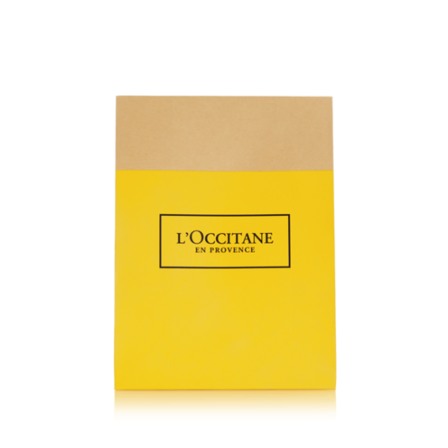
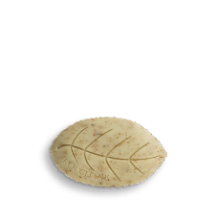
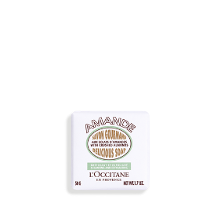
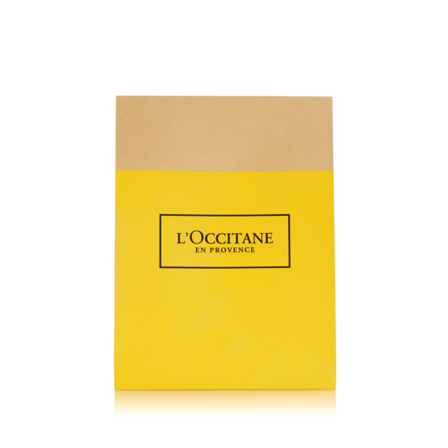
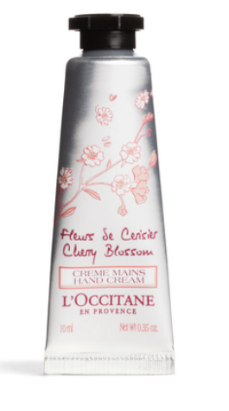
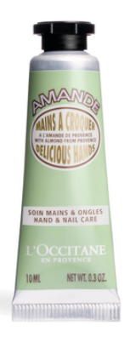
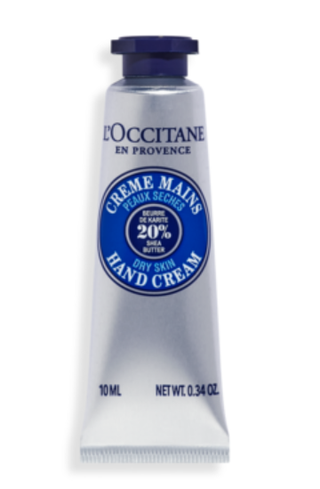
Gold Tin Bow 3 Hand Cream 10ml
€7,50 instead of €11,00
Shea Hand Cream 10ml
Golden Latte Light Hand Cream 10ml
Shea Chestnut Hand Cream 10ml
Four Verbena Soaps
€16,00 instead of €24,00
Six Almond Soaps
€21,00 instead of €30,00
Balloon with 3 Hand Cream 10ml
€11,00 instead of €14,00
- Cherry Blossom Hand Cream 10ml
Almond Hand Cream 10ml
Shea Hand Cream 10 ml

Slide 9
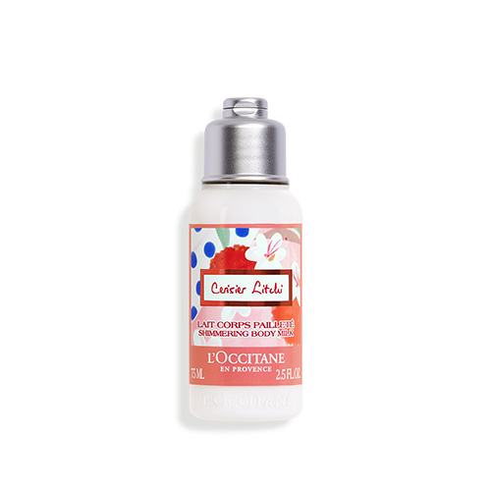
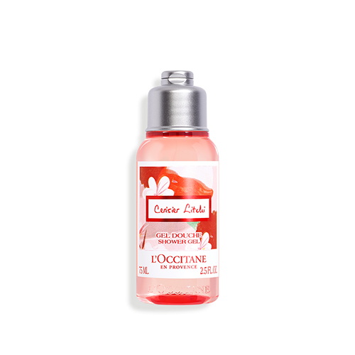
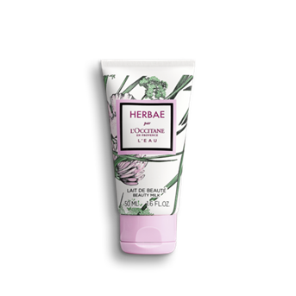
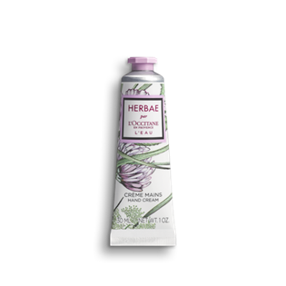
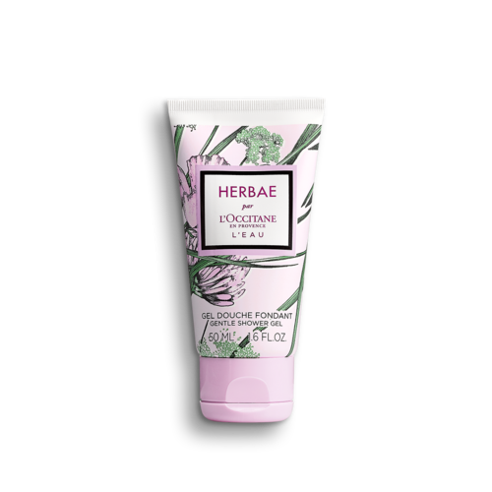
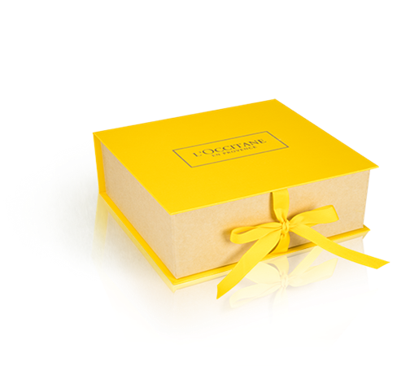
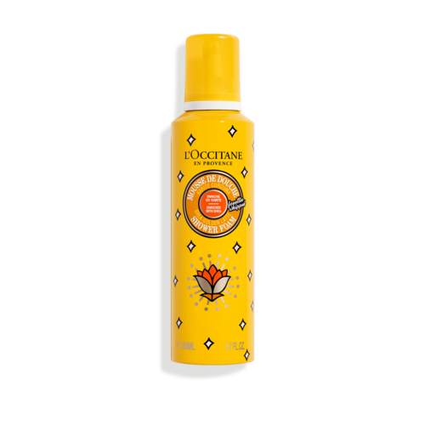
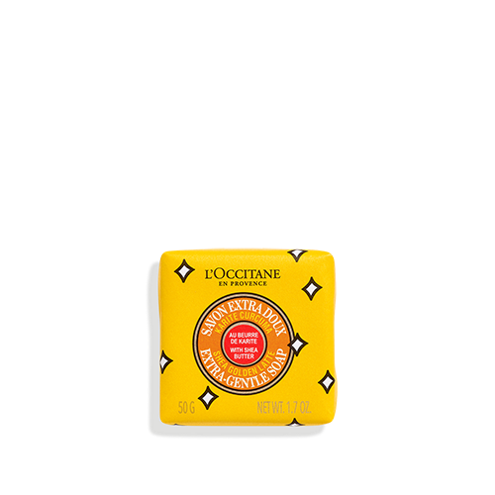
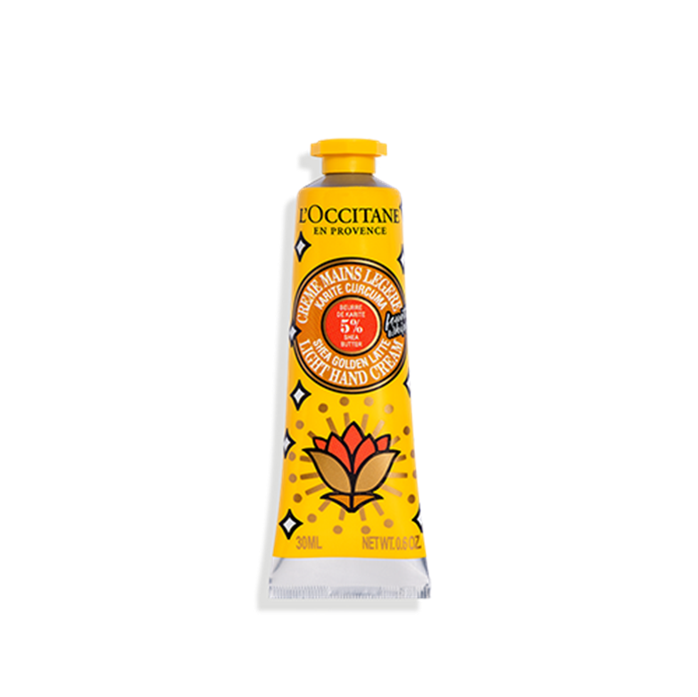
Trio Cherry Blossom Litchi
€15,50 instead of €23,50
Body Milk 75ml
Shower Gel 75ml
Hand Gel 30ml
The Herbae L’eau
Body Care Small Kit B
€19,00 instead of €23,50
Hand Cream 30ml
Shower Gel 50ml
Body Lotion 50ml
The Shea Golden Latte Bath Gift Set
€19,50 instead of €29,50
Soap 50gr
Shower Foam 200ml
Hand Cream 30ml

Slide 10
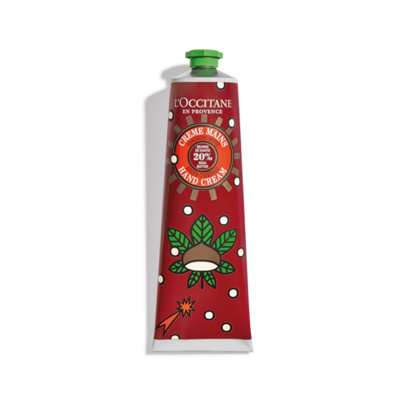
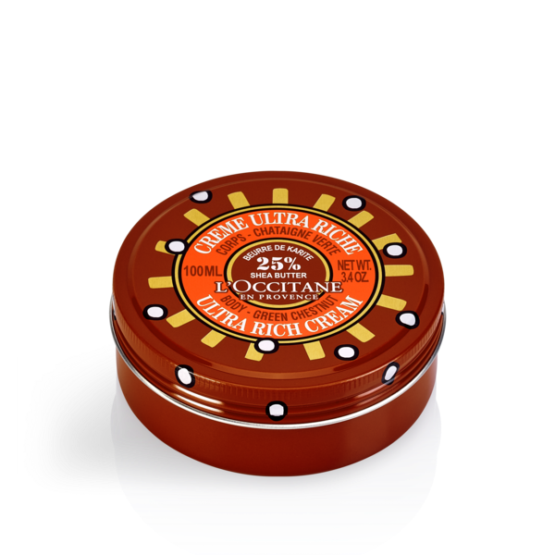
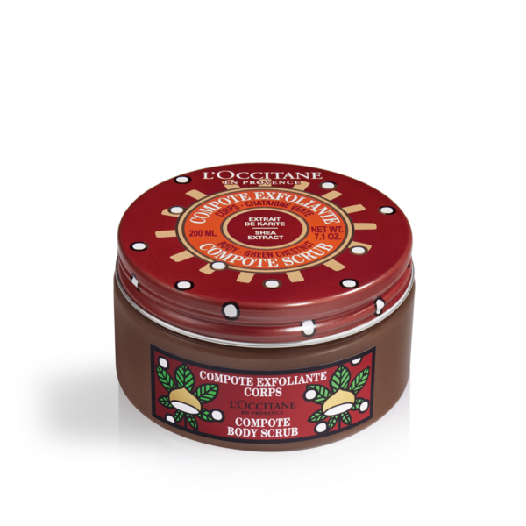
Shea Chestnut
Hand Cream 150ml
€16,00 instead of €24.00
Chestnut Ultra Rich
Body Cream 100ml
€16,50 instead of €24,50
Chestnut Compote
Body Scrub 200ml
€17,00 instead of €25,00
Trio Chestnut Shea Body Care
€15,00 instead of €22,50
Soap 50gr
Lip Blam 12ml
Hand Cream 30ml

Slide 11
Cherry Blossom Shower Gel 500ml
€19,00 instead of €28,00
Cherry Blossom Shim Lotion 500ml
€29,50 instead of €44,00
Lavender CBD Shower Gel 250ml
€10,50 instead of €16,00
Lavender CBD Body Milk 250ml
€20,00 instead of €30,00

Slide 12
PERFUME

Slide 13
Cherry Blossom Litchi
Perfume Gift Set
€60,50 instead of €90,00
FOR HER
- Eau de Toilette 50ml - Body Milk 250ml - Shower Gel 250ml
Eau Des Baux
Perfume Gift Set
€58,00 instead of €72,00
FOR HIM
- Eau de Toilette 75ml - Shower Gel 250ml

Slide 14
BODY CARE

Slide 15
Herbae L’Eau
Body Care Giftset
€40,00 instead of €49,50
FOR HER
Shower Gel 250ml
Body Milk 250ml
Hand Cream 30ml
Herbae L’Eau
Discover Gift Set
€19,00 instead of €23,50
FOR HER
Shower Gel 50ml
Body Lotion 50ml
Hand Cream 30ml
Neroli & Orchid Intense
Body Care Duo
€16,00 instead of €24,50
FOR HER
Shower Gel 250ml
Hand Cream 30ml
Notes:
Agrandir les tailles produits + changer les boites par les boites génériques
+ mettre les produits sur fond transparent

Slide 16
Almond Body Care Giftset B
€46,00 instead of €69,00
- Hand Cream 30ml
- Shower Scrub 200ml - Shower Oil 75ml - Concentrate Milk 100ml
Almond Shower Scrub Duo
€27,00 instead of €40,00
Notes:
Agrandir les tailles produits + changer les boites par les boites génériques
+ mettre les produits sur fond transparent

Slide 17
Cherry Blossom
Body Care Giftset
€25,50 instead of €38,00
Lip Balm 12ml
Soap 50gr
Hand Cream 150ml
Verbena
Body Care Giftset
€27,00 instead of €40,00
- Shower Gel 70ml
- Body Lotion 70ml
- Body Scrub 200ml
Shea Bergamot
Body Care Giftset
€37,50 instead of €56,50
Lip Balm 12ml
Body Milk 125ml
Hand Cream 30ml

Slide 18
FACE CARE

Slide 19
Face Mask Duo A
€26,00 instead of €33,50
3 in 1 Revitalizing Mask 75ml
Radiance Scrub 6ml
Face Mask Duo B
€26.00 instead of €33,50
Purifying Mask 75ml
3 in 1 Revitalizing Mask 6ml
PPL1RESETDUOUT21
Reine Blanche Duo
€42,00 instead of €63,00
Bright Lotion 200ml
Intense Foam 150ml

Slide 20
Cleansing Gel-to-Foam
200ml
€13,50 instead of €20,00
Cleansing 3-in-1
Micellar Water 200ml
01MW500I20
€16,00 instead of €20,00
Cleansing Infusion
Oil to Milk 500ml
€31,00 instead of €46,00
Cleansing Cream-to-Foam
125ml
€16,00 instead of €20,00

Slide 21
Thank you
Christmas Gifting
Whilst the festive season means different things to everyone, we are united in a simple wish to practice gratitude and give back. All of our Luxury Beauty Christmas gifts are beautifully presented with our signature L'OCCITANE gift wrapping.

